Slide 1
Epigenetic Responses to Low Dose Ionizing Radiation
Randy L. Jirtle, Ph.D.
NC State University
Raleigh, NC
University of Wisconsin
Madison, WI
Origins
Artist: Collin Murphy
Notes:
1
One of the most important question in biology is “Why do people vary in their susceptibility to diseases?” Since we are in the era of the genome, much time, money and effort have gone into identifying SNPs associated with various diseases.
Although this approach has been successful (e.g. BRAC1 & BRAC2), it has been less successful in determining the causes of neurological disorders.
To me, a more fundamentally important question is why do monozygotic twins, who are basically genetically identical, also vary in their disease susceptibility if the only thing that is important in this process is genetic variation?
One reason for this is that although identical twins have the same genome, they most likely do not have identical epigenomes. This concept is shown in the painting we had commissioned from Collin Murphy for the 2005 Environmental Epigenomics meeting at the Washington Duke Inn in Durham, NC.

Slide 2
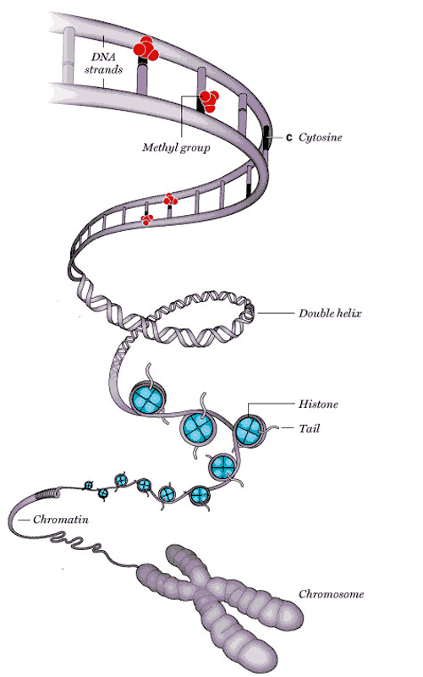
What is Epigenetics?
Two Main Components
of the Epigenetic Code
DNA Methylation
Methyl groups added
to the cytosine base of
DNA alter gene activity.
Epi·ge·net·ics - “above genetics”
Epigenetics research refers to the study of heritable changes in gene function that occur without a change in the sequence of the DNA. (i.e. DNA methylation & chromatin structure)
Histone Modifications
Molecules attach to the
tails of histones, and help
determine gene function.
Washington Post
http://www.geneimprint.com
Notes:
2
Epigenetics simply means “above the genetics”, like epicenter means “above the center.”
2) Two main components of the Epigenetic Code – DNA methylation and Histone marks that together either cause the chromatin to condense and become inactive of relax so genes can be transcribed.
3) Modern Definition of Epigenetics: Epigenetics research refers to the study of heritable changes in gene function during cell replication that occur without a change in the sequence of the DNA.

Slide 3
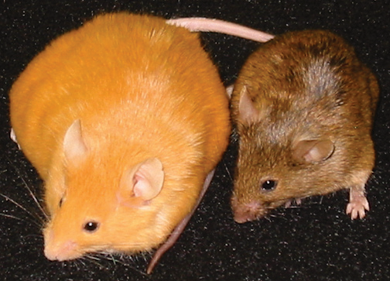
The Agouti Sisters
“For every problem in a given discipline of science, there exists a species ideal for its solution.” Edward O. Wilson
http://www.geneimprint.com
Notes:
AGOUTI SISTERS
The species ideal for studying the role of epigenetics in fetal origins of adult disease susceptibility is the Agouti viable yellow (A^{vy}) mouse.

Slide 4
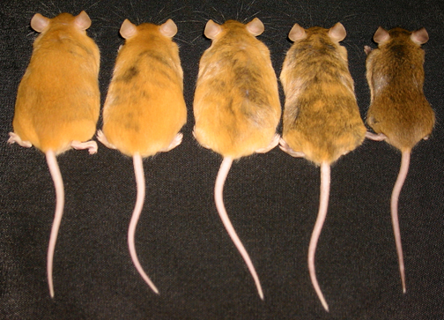
Fetal Origins of Adult Disease
Susceptibility
Yellow
Slightly
Mottled
Mottled
Heavily
Mottled
Pseudo-
agouti
IAP
A^{vy}
3’
5’
A, a
5‘
3‘
1A
~15 Kb
PS1A
2
4.1 Kb
~100 Kb
100
Control Diet
100
Supplemented Diet
50
90
90
Control Diet
80
80
Pseudo-agouti
80%
40
Supplemented Diet
(Folic acid, Vitamin B₁₂,
Choline chloride and
Betaine) p = 0.008
70
70
60
60
30
Cells Methylated (%)
Heavily Mottled
50%
A^{vy} Offspring (% of Total)
50
50
20
40
40
30
30
Mottled
26%
10
20
20
Slightly Mottled
13%
10
10
Yellow
7%
0
0
0
Yellow
Slightly
Mottled
Mottled
Heavily
Mottled
Pseudo-
agouti
0
1
2
3
4
5
6
7
0
1
2
3
4
5
6
7
CpG Site in A^{vy} PSIA
CpG Site in A^{vy} PSIA
Waterland & Jirtle, Mol. Cell Biol. 23: 5293-5300, 2003
http://www.geneimprint.com
Notes:
1) Describe the agouti locus, and the relationship between IAP methylation and phenotype (i.e. coat color, weight, susceptibility to diabetes and cancer).
2) Agouti mouse as biosensor and the effect of maternal nutrition.
3) Relationship between maternal nutrition, coat color and DNA methylation of the IAP.
4) This study was transformational for our understanding of the fetal origins of adult disease susceptibility field of research. Before the publication of this paper epigenetics was NEVER referred to as the mechanism by which early exposure to environmental factors altered adult disease risk, whereas, after 2003 epigenetics is always discussed as the mechanism for this phenomenon.
5) Consequently, basically all medical fields of research were seen to fit under the BIG TENT OF EPIGENETICS! This in part is responsible for the publications in epigenetics GOING VERTICLE!

Slide 5
Radiation Effects on the
Epigenome
Support: DOE Low Dose Radiation Research Program
O’Keeffe Foundation Award
http://www.geneimprint.com
Notes:
Radiation Effects on the Epigenome
Reactor Core – Cherenkov Radiation
My research career has come full circle with the merging of the field of epigenetics with radiation biology!

Slide 6
Low Dose X-ray Exposure
Viable Yellow Agouti Mice
Radiation Dose Response
Male Coat Color & DNA Methylation
Irradiation of
ES Cells
60
Brown Male Mice
60
0
21
43
50
Yellow Male Mice
**
**
50
*
p < 0.05
24
29
Time (days)
40
**
p < 0.01
*
*
40
Birth
22
Implantation
30
19
30
Gastrulation
Tissue Collection
A^{vy} Offspring (%)
13
Methylation (%)
20
26
20
10
10
0
0
0.0
0.4
0.7
1.4
3.0
7.6
Low doses of ionizing radiation increase the incidence of brown offspring by enhancing DNA methylation.
Dose (cGy)
Chest X-ray
CT Scan
Irradiated Agouti Offspring
Coat Color Distribution
Thus, low doses of X-rays induce a positive adaptive response in these mice by altering the epigenome.
Bernal et al. FASEB J: 27: 665-671, 2013
http://www.geneimprint.com
Notes:
Low dose radiation response of agouti mice.
Normal Agouti mouse coat color distribution
Experimental design/timetable
Talk about doses used in terms of human exposure (0-0.4 cGy X-rays, 1 cGy CT Scan, 10 cGy recommend abortion)
Sex effect – epigenetic effect present in male but not female mice
Yellow/brown offspring number and average Agouti locus methylation versus radiation dose.

Slide 7
X-ray Exposure
Antioxidant Supplementation
Male Agouti Mouse Coat Color
Liver DNA Methylation
16
*
16
Antioxidant Supplementation
l-selenomethionine
Vitamin C
Vitamin E
Succinate
Alpha-lipoic acid
N-acetyl cysteine
50
*
p < 0.05
14
*
p < 0.05
14
*
12
12
40
38
10
10
30
Offspring (Number)
B:Y Ratio
Methylation (%)
8
8
27
23
6
6
20
4
4
10
2
2
0
0
0
0.0
3.0
3.0 + AO
0.0
3.0
3.0 + AO
Exposure (cGy)
Exposure (cGy)
Antioxidants negate the increased DNA methylation and block the positive adaptive response induced by low doses of X-rays.
The positive adaptive response induced by low doses of X-rays is mediated in part through oxidative stress.
Bernal et al. FASEB J: 27: 665-671, 2013
http://www.geneimprint.com
Notes:
Male Agouti mouse coat color versus radiation dose and anit oxidant exposure
Radiation-induced epigenetic adaptive response negated by supplementing maternal diet with anti oxidants (e.g. vitamin E, vitamin C, etc.).

Slide 8
Radiation Risk Assessment
Hormesis
(Greek hormaein- “to excite or stimulate”)
LNT Model
Negative Biological Effects
(Yellow Obese Mice)
0
10 cGy
Radiation Dose
http://www.geneimprint.com
Notes:
Adaptive epigenetic response – LNT versus Hormesis Risk Assessment Models
Future Studies – role of epigenetics in human risk to radiation exposure

Slide 9
Questions
Do other frequencies of electromagnetic radiation and high energy particles also alter the epigenome?
What are the signal transduction pathways that link the formation of ROS to altered DNA methylation?
Does low dose ionizing radiation alter the human epigenome?
Is the LNT model potentially inappropriate for estimating human risk to low doses of ionizing radiation?
http://www.geneimprint.com
Notes:
RESEARCH SUMMARY
Being able to condense your research discoveries into one sentence is humbling!
Being able to make this statement with certainty has changed the way we view disease formation forever!

Slide 10
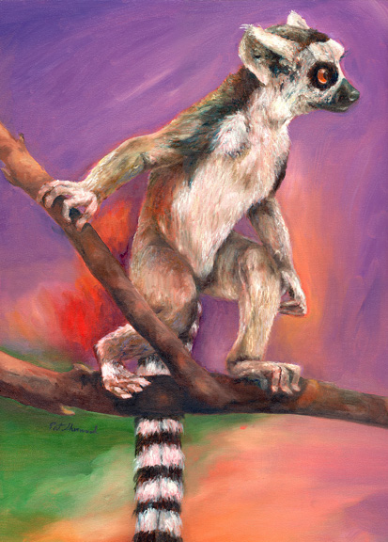
Questions
Artist: Pat Sherwood

