Slide 1
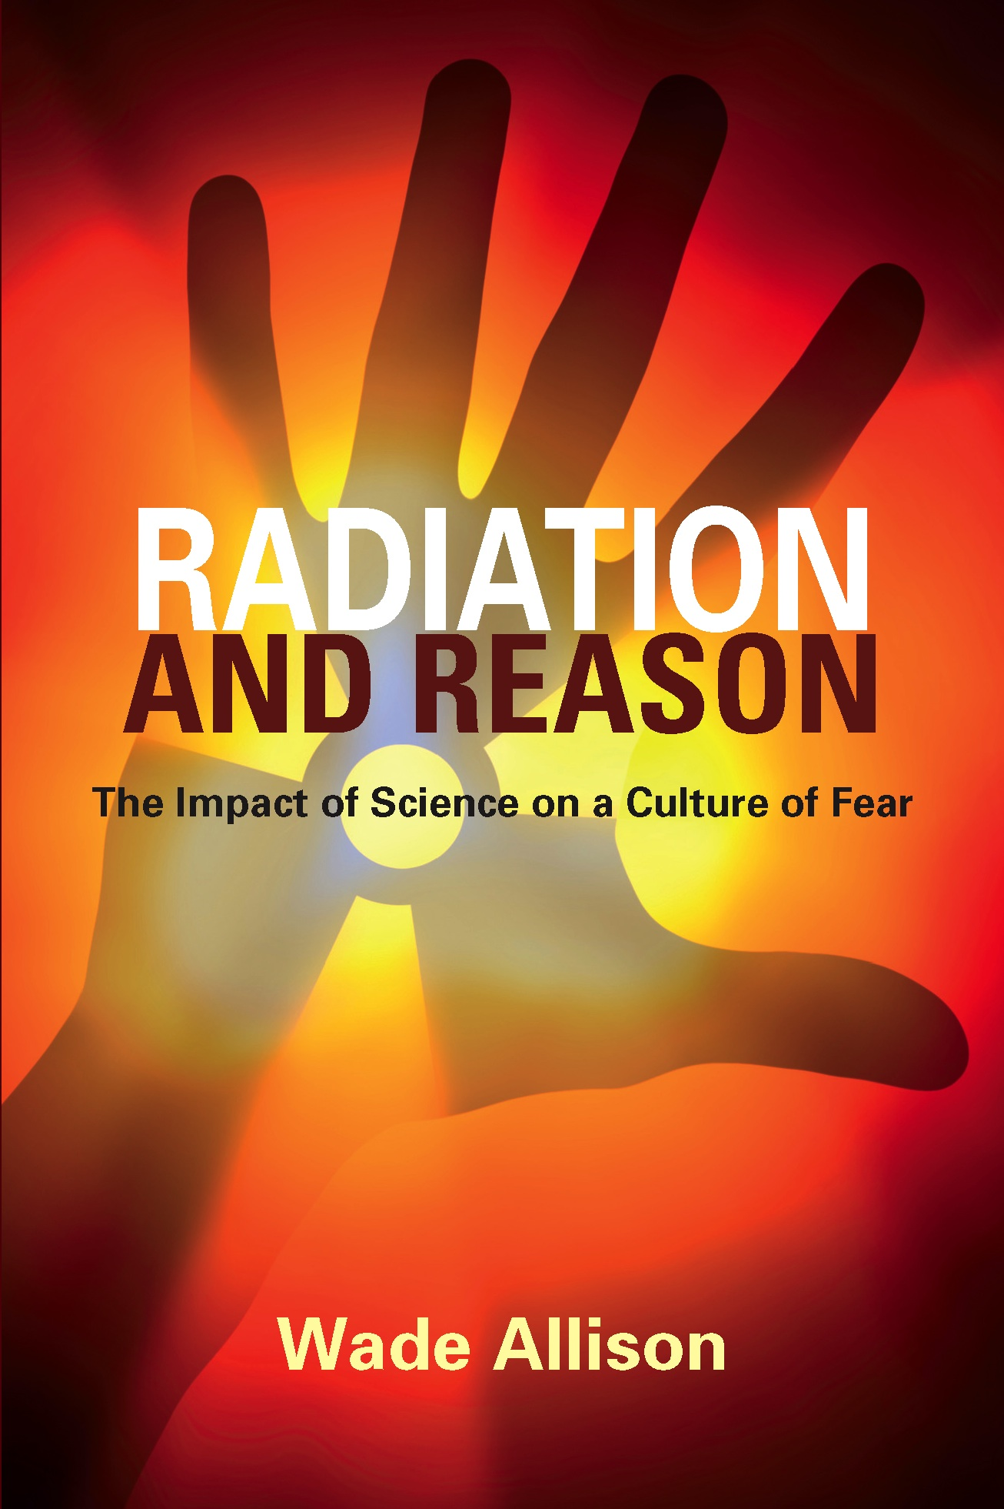
Public Support for Nuclear Energy
Wade Allison
Physics Department and Keble College
Oxford University, UK
wade.allison@physics.ox.ac.uk
www.nuclear4life.com
www.radiationandreason.com
2 October 2018
ANS/HPS Meeting, Pasco, Washington, USA
1
Notes:
1

Slide 2
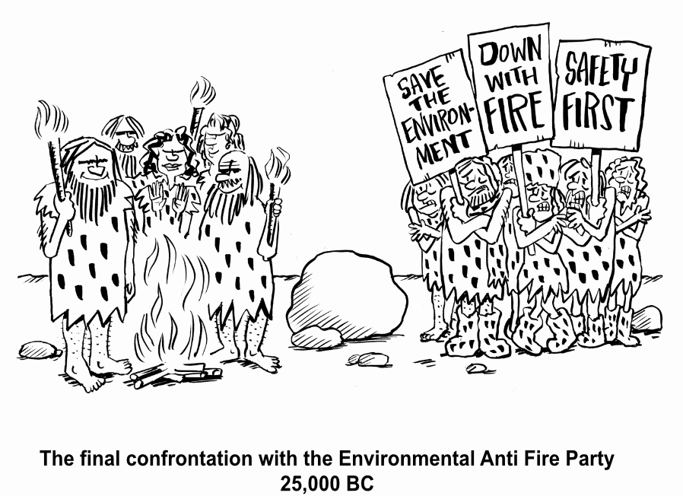
This Photo by Unknown Author is licensed under CC BY-SA
2 October 2018
“Public Support for Nuclear Energy” ANS/HPS Meeting, Pasco, Washington, USA
2
Notes:
2
Clever ancestor brought fire into home
Green environmentalists went home safe cold hungy – but died out
Red leaders went on , sailing ships for trade, ater and wind power for mills
In this case Red had won, green injurious to life
But these power sources were limited and intermittent
Forests were felled and ships becalmed
Industrial Revolution: coal and oil for replaced biofuels,
Steam replaced water and wind for transport and shipping,
steel replaced wood for construction
Power was available anytime anywhere
Transformative effect on life
But the effect on nature had been neglected.
Now global effect on the climate widely accepted

Slide 3
Choosing the source of energy
 |  | Energy density joules per kg | Good? | Bad?
“RENEWABLES” | Power of water, wind, solar and biofuels etc | 100-1000 | Familiar and accepted | 1) Huge power plants destroy nature 2) Unreliable
CARBON | Coal, oil, gas, wood, candles, biofuels | 24 million | Best choice except for emissions | Atmospheric emission carbon dioxide
NUCLEAR | Fission (or fusion) | 4 trillion | Compact safe reliable no impact on nature | Unfamiliar and feared
2 October 2018
W Allison “Public Support for Nuclear Energy” ANS/HPS Meeting, Pasco, Washington, USA
3
Notes:
3

Slide 4
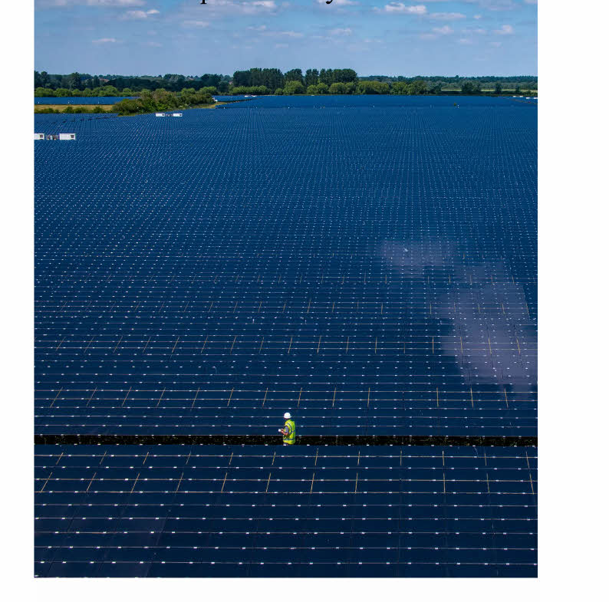
2 October 2018
“Public Support for Nuclear Energy” ANS/HPS Meeting, Pasco, Washington, USA
4
Notes:
4

Slide 5
Choosing the source of energy
 |  | Energy density joules per kg | Good? | Bad?
“RENEWABLES” | Power of water, wind, solar and biofuels etc | 100-1000 | Familiar and accepted | 1) Huge power plants destroy nature 2) Unreliable
CARBON | Coal, oil, gas, wood, candles, biofuels | 24 million | Best choice except for emissions | Atmospheric emission carbon dioxide
NUCLEAR | Fission (or fusion) | 4 trillion | Compact safe reliable no impact on nature | Unfamiliar and feared
2 October 2018
W Allison “Public Support for Nuclear Energy” ANS/HPS Meeting, Pasco, Washington, USA
5
Notes:
5

Slide 6
Biology’s defence strategy
Using multiple copies on two scales: 1. many individual organisms, 2. many cells within each organism In both cases cyclic replacement In both cases defence by talking, hence
1. Cellular Bystander Effect 2. Social Bystander Effect the talking should be informed
2 October 2018
“Public Support for Nuclear Energy” ANS/HPS Meeting, Pasco, Washington, USA
6
Notes:
Life survives attacks statistically Organisms

Slide 7
Defence against an oxidative attack
Required for survival over 3500 million yrs Signal too small for individual scale So protection devolved to cellular scale by repair/replacement/anti-ROS/adaptation/immune Response is resource-limited, hence nonlinear like other resource-limited systems eg in electronics, management,… Linearity would be unnatural in an evolved or designed system. Public: show the evidence!
2 October 2018
“Public Support for Nuclear Energy” ANS/HPS Meeting, Pasco, Washington, USA
7

Slide 8
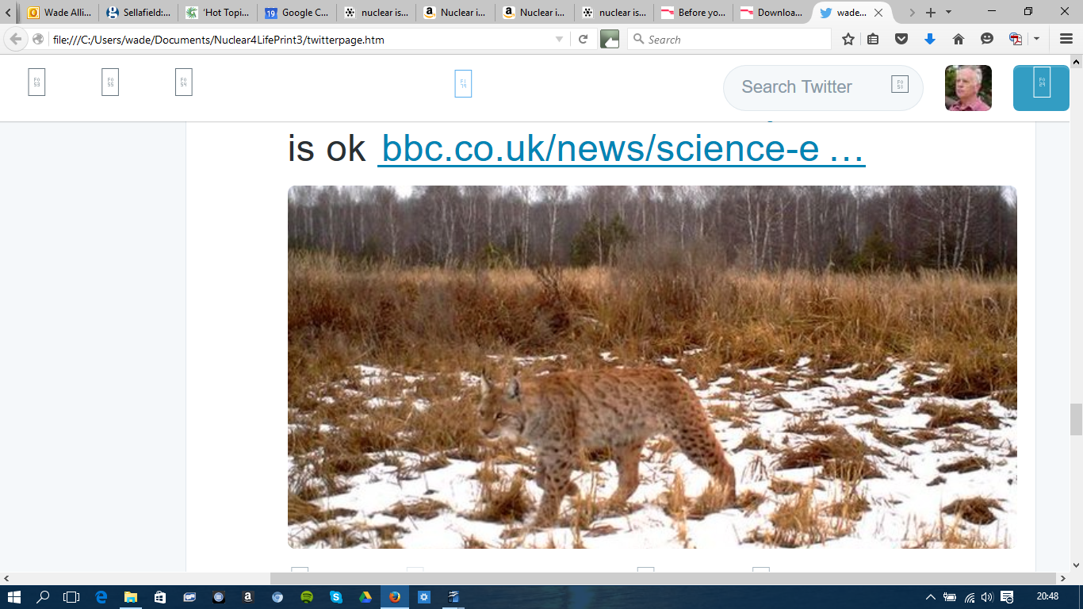
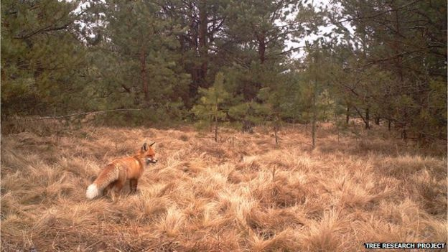
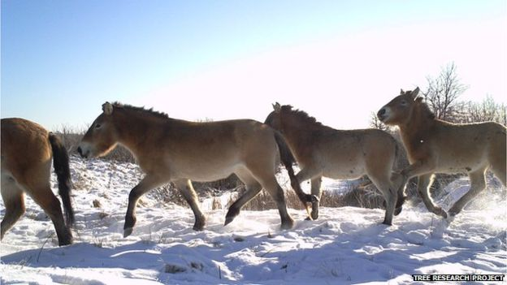
Animals at Chernobyl, individuals unaware of radiation but with complete cellular protection Benefiting from absence of humans!
2 October 2018
“Public Support for Nuclear Energy” ANS/HPS Meeting, Pasco, Washington, USA
8
Notes:
8

Slide 9
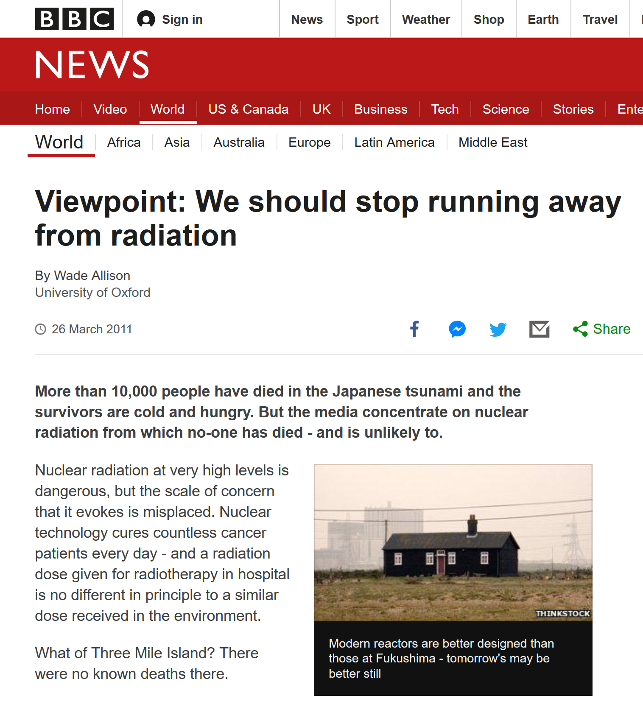
Evidently the curse that damaged human lives came from regulations, not radiation
com/qUx7WZD5P1Nfu4CP/www.bbc.comhttps://screenshots.firefox.com/qUx7WZD5P1Nfu4CP/www.bbc.comttps://screenshots.firefox.com/qUx7WZD5P1Nfu4CP/www.bbc.comreenshots.firefox.com/qUx7WZD5P1Nfu4CP/www.bbc.com

Slide 10
The radiation dose-rate safety threshold
to protect the public from harm, not the authorities from litigation. ICRP 1934: 60 mGy per month We know enough for safety, Lauriston Taylor (1980). Same for all. Youth has the best immunity.
2 October 2018
“Public Support for Nuclear Energy” ANS/HPS Meeting, Pasco, Washington, USA
10

Slide 11
Recommendations 1/2
Reinstate the use of a threshold dose rate as the determining factor in Radiation Protection, for instance at 60 mGy per month (ICRP 1934).
Cease reference to accumulated dose as a significant risk factor in Radiation Protection.
Cease the use of linearity and related risk coefficients.
Educate, reassure and inform the public and all authorities, including UN, that ionising radiation at rates below threshold is not harmful and that no distinction is needed for children or pregnant mothers.
Teach every school child how life is protected by the natural mechanisms studied in science.
2 October 2018
W Allison “Public Support for Nuclear Energy” ANS/HPS Meeting, Pasco, Washington, USA
11

Slide 12
Recommendations 2/2
Facilitate the use and construction of nuclear power plants to mitigate climate change and enable ongoing economic activity.
Reduce the cost of nuclear technology by a large factor by ensuring that all safety provision is based on science.
Construct fast nuclear powered shipping for cargo and passengers, reducing air transport.
Explain that Radon in the natural environment is not a danger.
Explain that radioactive waste is safely handled by available technology and presents no problem.
2 October 2018
W Allison “Public Support for Nuclear Energy” ANS/HPS Meeting, Pasco, Washington, USA
12

